Slide 1

Automated Grading System of OMR & Handwritten Text
Team members (Group 64):
Darshan Hassan Shivakumar (12300360)
Sachin Poojary (12300743)
Nabeel Ahmad (12303956)

Slide 2
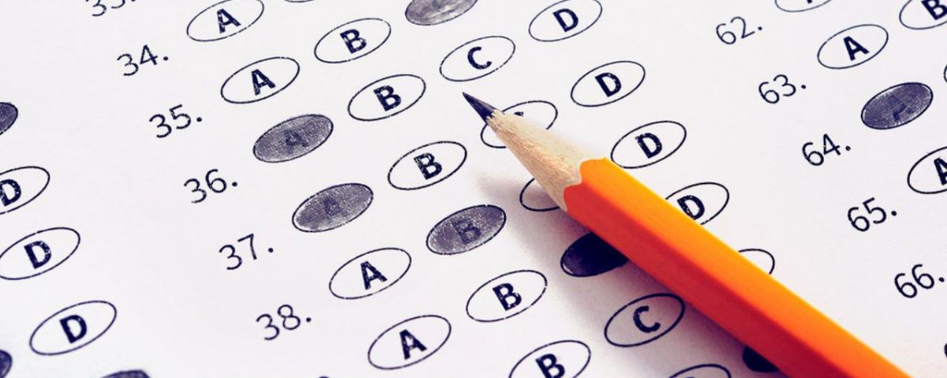
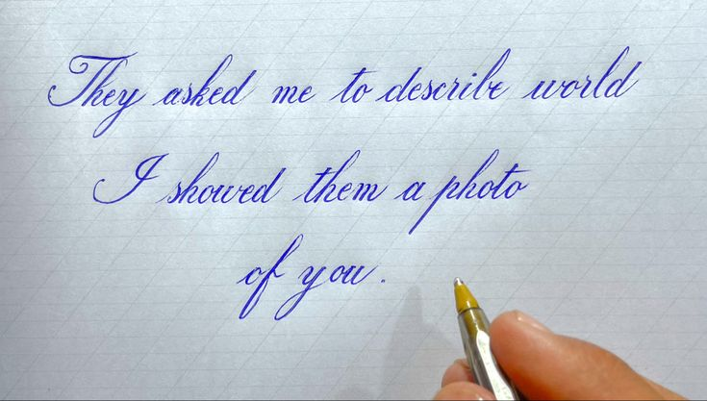
Introduction
An automated grading system for Optical Mark Recognition (OMR) and handwritten text is an advanced tool designed to streamline the evaluation process of student assessments.
By using OpenCV library & OCR technologies, our system can process both OMR & handwritten text.

Slide 3
Motivation
Time-saving: Automated grading systems significantly reduce the time educators spend on grading.
Scalability: These systems can handle large volumes of assessments, making them ideal for standardized testing environments.
Elimination of Bias: Automated systems provide uniform grading criteria, ensuring all students are graded consistently, reducing the potential for human bias.
Instant Results: Students receive immediate feedback on their performance. This immediate response helps in identifying areas of improvement.
Error Reduction: Minimizes human error in grading, ensuring that assessments are accurate and reliable.

Slide 4
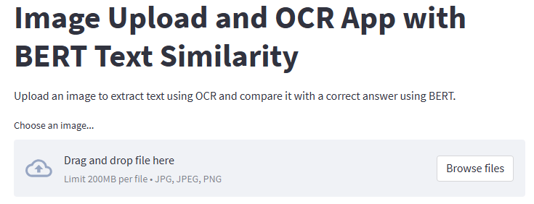
Streamlit Integration
Streamlit is an open-source framework for building interactive web applications using Python. We use Streamlit to build a web app that allows users to upload images, process the data, and display the results.
File Upload Upload image of OMR answers and handwritten responses.
Image Display Uploaded images are displayed for verification.
Processing and Analysis Images are processed using OpenCV and OCR technologies.
Feedback Real-time results are displayed to the users.

Slide 5
AsposeOCR
AsposeOCR is an API that provides Optical Character Recognition (OCR) capabilities for computer vision applications, which are popular for their document manipulation and processing capabilities. In our project, It’s specifically focuses on extracting text from images using OCR technology.
Integrating AsposeOCR into our application streamlined the process of extracting textual information from scanned documents, enhancing efficiency and accuracy.
Outcome: The result of using AsposeOCR is a plain text representation of the content found within the image.

Slide 6
Generate text embeddings with BERT
BERT is based on the Transformer architecture, a type of neural network architecture designed to handle sequential data such as text. Transformers allow for capturing dependencies and relationships between words in a sentence more effectively.
BERT embeddings capture the semantic meaning and context of words within the extracted text, considering how each word relates to its surrounding words.
Outcome: The result of using BERT is to generate text embeddings for our text from the image.

Slide 7
Cosine similarity
Cosine similarity provides a quantitative measure to assess the semantic similarity between expected and correct answers in textual analysis tasks. By comparing vector representations of the answers, it helps in evaluating the accuracy, relevance, and semantic equivalence of textual outputs.
Outcome: The goal is typically to quantify how similar extracted and correct text are in terms of their semantic meaning or content.

Slide 8
OpenCV Usage & Processes involved for OMR
OpenCV is used for OMR task on a given image. It can be integrated into an OMR system to extract, analyze, and grade answers from scanned images efficiently.
Image Reading and Preprocessing The input image is resized to a standard size to ensure consistency in processing. Convert into Grayscale simplifies subsequent image analysis.
Image Enhancement Reduce noise and enhance edges in the grayscale image. Detecting edges in the blurred image, crucial for identifying contours.

Slide 9
OpenCV Usage & Processes involved for OMR
Contour Detecting & Preprocessing Identify contours in the Canny edge-detected image, which likely represent the outlines of OMR bubbles or regions
Answer Region Extraction A specific region of interest (ROI) containing the answer bubbles is extracted using perspective transformation and displayed, aiding in visualization and further analysis..
Thresholding and Pixel Counting Convert the warped grayscale image into a binary format, enhancing the contrast between marked and unmarked regions. Count non-zero (marked) pixels in segmented regions (boxes), providing data for subsequent answer identification.

Slide 10
OpenCV Usage & Processes involved for OMR
Answer Grading Compare detected answers against expected answers, evaluating correctness based on pixel counts and determining grading.
Scoring and Output Compute the score based on the number of correctly identified answers relative to the total number of questions.

Slide 11
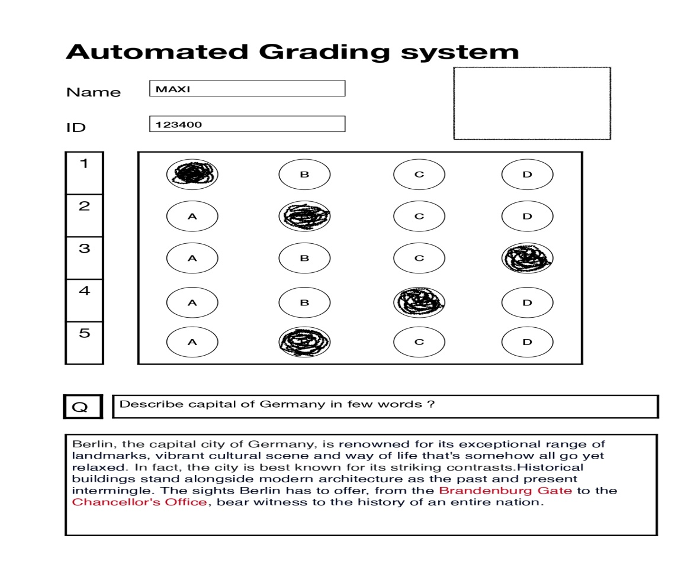
Final Score Prediction
We compute the average of the OMR score with the handwritten text score to predict the final results.

Slide 12
References

Slide 13
Thank you!!

